Slide 1
Lawyers for Good Government
Making It Easy to Volunteer
Laura Klein, Senior Manager of Pro Bono Initiatives
Georgia Lawyers for the Rule of Law | April 29, 2026

Slide 2
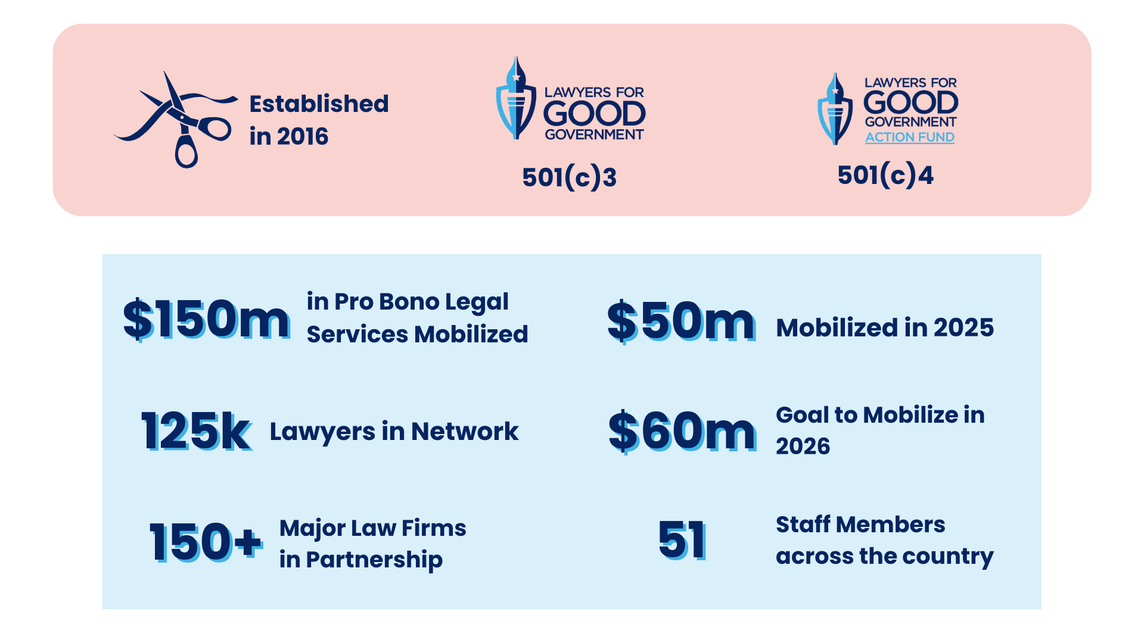
Lawyers for Good Government

Slide 3
L4GG: 3 Pillars
1. Democracy & Rule of Law
No person or institution is above the law. Our democracy only works if government power is constrained by constitutional limits and protected by an independent judiciary.
We advocate for free and fair elections, anti-corruption measures, and the right to protest, organize, and hold power accountable.
2. Civil & Human Rights
We fight for equal justice under the law—regardless of race, religion, gender, immigration status, or economic background.
We recognize that human rights aren’t granted by the government. They’re universal. And they include reproductive freedom, LGBTQ+ rights, immigrant rights, and the dignity of every person.
3. Climate Change & Environmental Justice
Government has a duty to act on the climate crisis—urgently and based on science.
We work to ensure that communities of color and low-income communities aren’t left behind in this fight. That’s what environmental justice means.
Notes:
Founded L4GG in 2016 to harness the power of the legal profession for social good
We've generated over $100 million in pro bono legal services through our network of 125,000+ attorneys and partnerships with 150 major law firms nationwide
Our staff of 36 professionals spans 17 states, and we're growing to 45 by year-end
In 2024 alone, we deployed $30 million in pro bono services and project exceeding $50 million in 2025

Slide 4

How we support pro bono volunteers
Resources:
Malpractice Insurance
Westlaw Access
Training
Mentoring
Ethical Tools:
Limited and Full Scope Opportunities
Co-Counsel Arrangements
Conflicts Checks
Volunteer Agreement
Engagement Letter
Scripted client preparation

Slide 5
Pro Bono Litigation Corps
Goals of the Program
1️⃣ Expand the Supply of Qualified Pro Bono Litigators
Recruit and support experienced litigators who are retired, unaffiliated, or recently left government or big law.
Re-engage this untapped pool of talent as co-counsel or lead counsel in high-impact litigation.
2️⃣ Provide the Infrastructure They Need to Serve
Offer malpractice insurance, secure communication systems, and administrative and paralegal support.
Create the operational backbone that lets volunteers focus on lawyering, not logistics.
3️⃣ Strengthen Access to Justice through Strategic Litigation
Partner with NGOs, advocacy orgs, and coalitions to bring cases defending democracy, civil rights, and the environment.
Prioritize impact cases where plaintiffs can’t secure representation due to political/resource barriers.
4️⃣ Reinforce the Rule of Law and the Profession’s Ethical Mandate
Empower lawyers to uphold their oath to defend the Constitution.
Restore confidence that the legal community will always stand against abuse of power.

Slide 6
Models for Volunteer Involvement
Lead Counsel
Pro Bono Attorney provides direct representation to client with L4GG serving as co-counsel and offering support and resources as needed. Examples:
Federal Whistleblower Cases
Immigration Habeas Matters
FOIA
Team Model
No one volunteer is responsible for the case. L4GG oversees case and involves pro bono attorneys in discrete tasks. Examples:
Court of Federal Claims Cases
Grant Conditions
Research and Amicus Briefs

Slide 7
Project Corazon
Immigration Legal Assistance
1️⃣ Detention Bridge
Recruit licensed attorneys to conduct intake interviews with detainees at Fort Bliss in El Paso, TX
Referrals for habeas relief, conditions of detention litigation, other assistance
2️⃣ Work Permit Clinics
Firms volunteer to host remote or in person clinics
L4GG vets clients and trains volunteer attorneys to assist clients in completing and filing employment authorization documents
3️⃣ Interpreters
We need interpreters for all of this work as well as PBLC litigation
Interpreters can be law students, legal assistants, attorneys, or non-legal volunteers

Slide 8
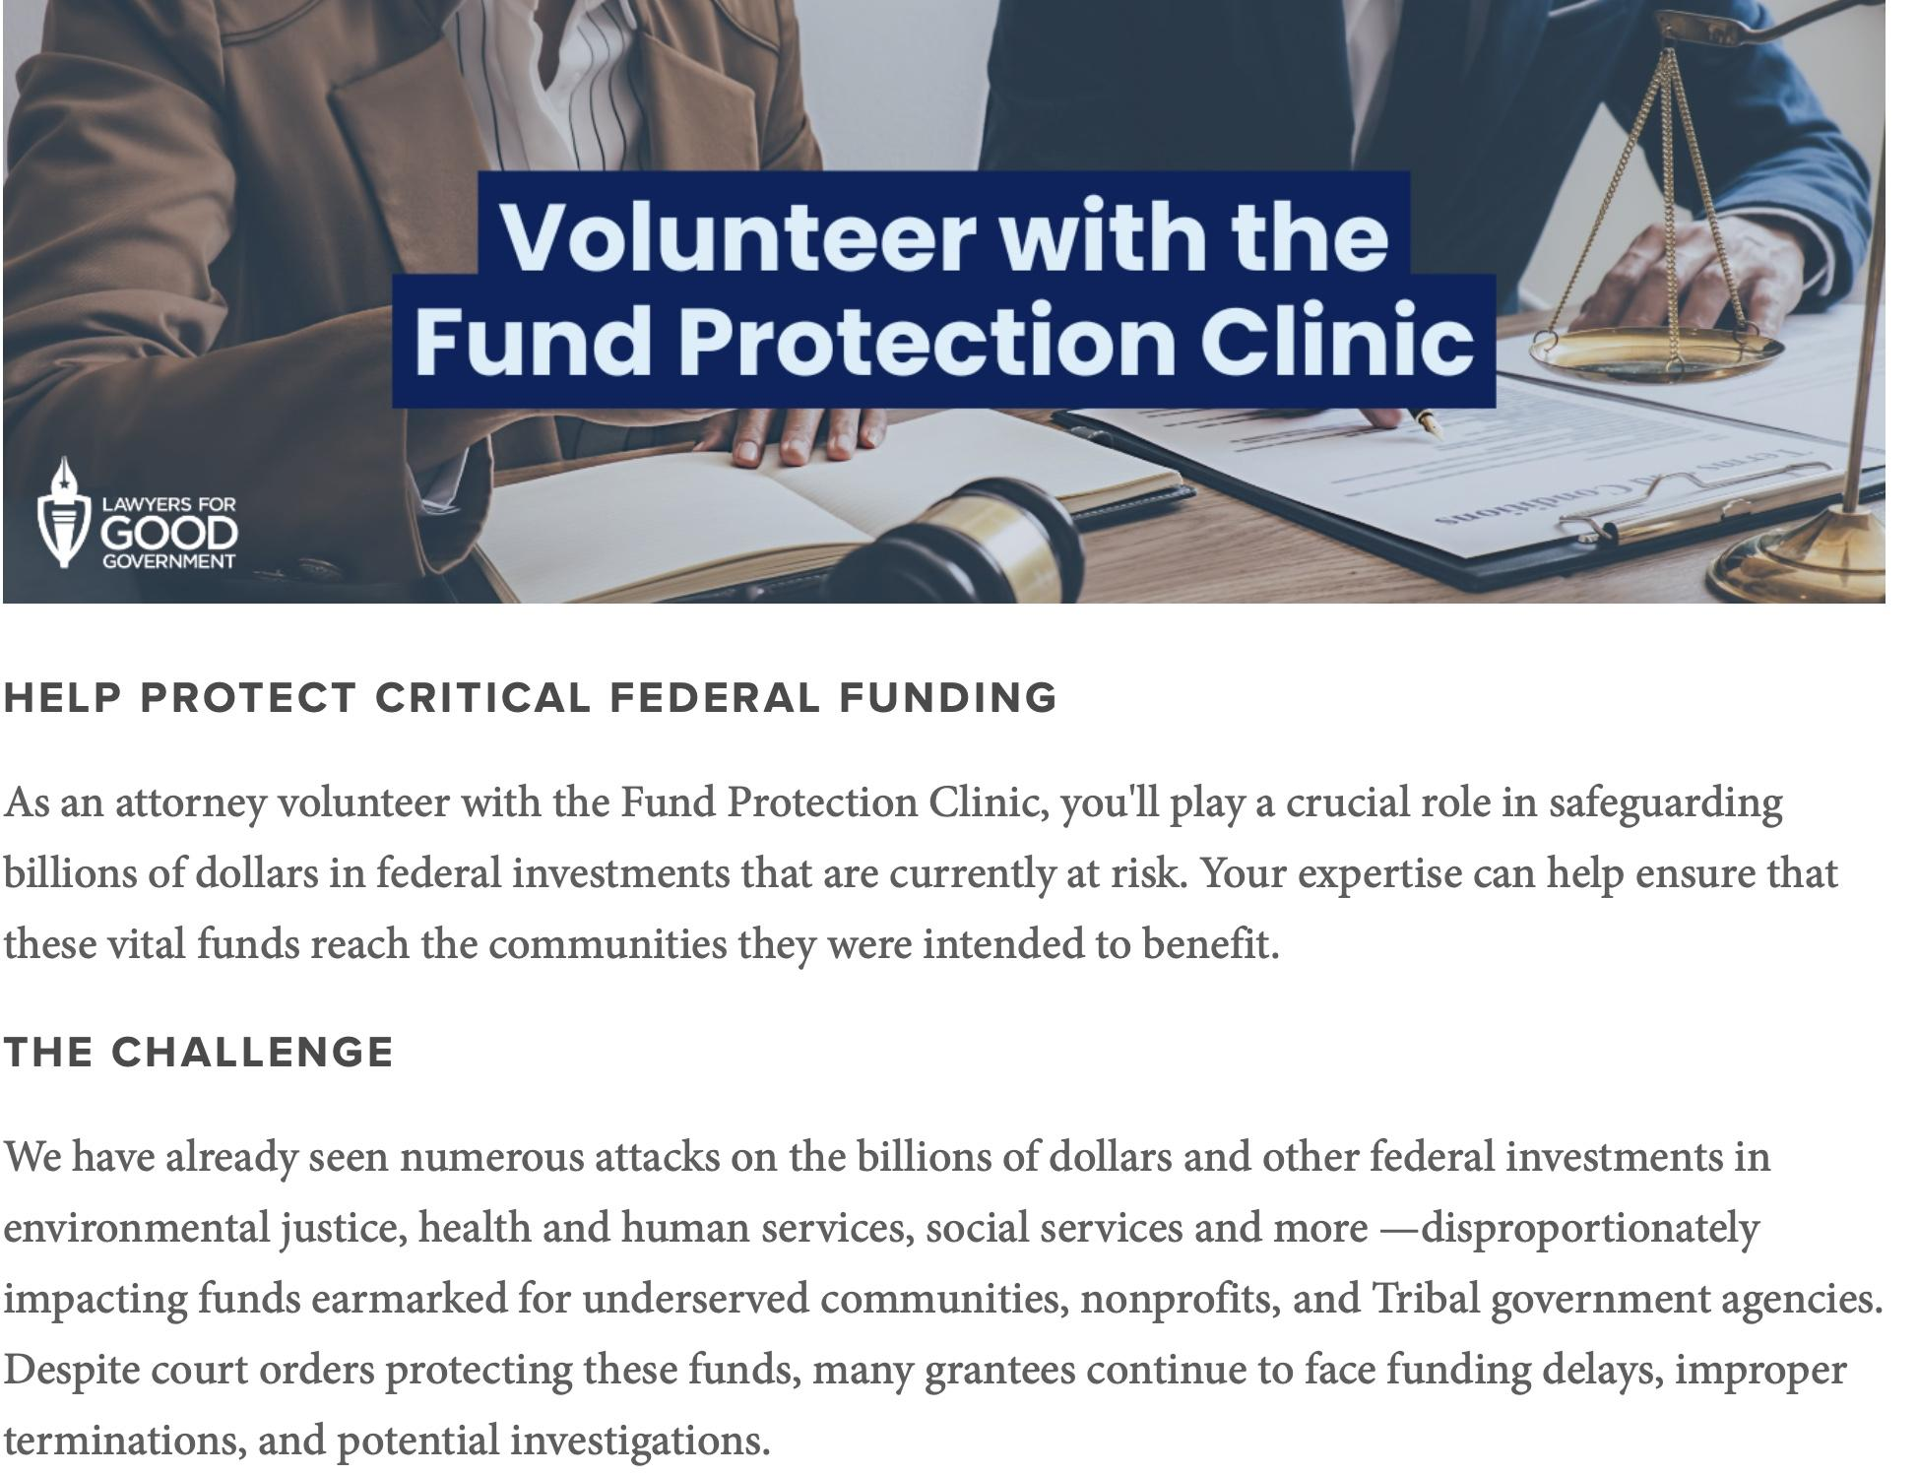

Slide 9
L4GG Pro Bono Opportunities
Additional Pro Bono Opportunities!
Policy Resource Hubs for Reproductive Health and Transgender Rights
State Legislative Advocacy Academy
Law Day of Action on May 1
Impact Docket: Bite-sized opportunities for engagement
L4GG.org/ImpactDocket
Find more opportunities here: L4GG.org/Volunteer
Questions? Contact Laura Klein, LKlein@lawyersforgoodgovernment.org

